Slide 1
Feature Selection
and
Overfitting
Presenter: Katyaini

Slide 2
Feature Engineering
Feature engineering is the process of using domain knowledge to extract features from raw data via data mining techniques. These features can be used to improve the performance of machine learning algorithms.
For instance interpolating missing data; converting it to a form that the machine learning algorithm takes as input( for text data this could be converting it to a one-hot encoding), outlier detection, log transform
Notes:
1)It helps to handle skewed data and after transformation, the distribution becomes more approximate to normal.

Slide 3
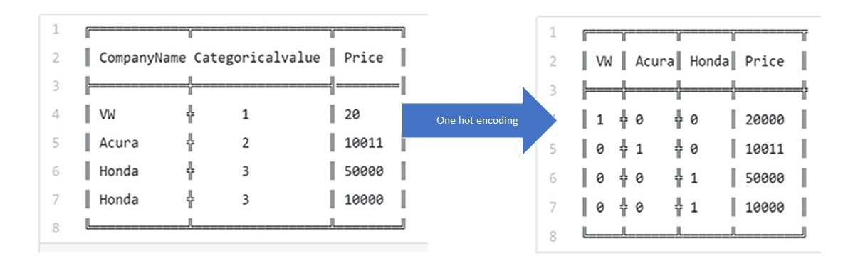
One-Hot Encoding
A one hot encoding is a representation of categorical variables as binary vectors.

Slide 4
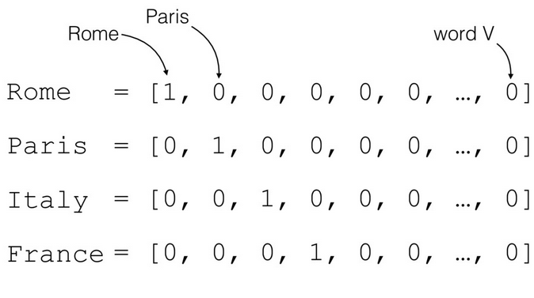
How it works with text data
So what are some issues that might pop up using this approach?
Un-ordered, therefore the context of words are lost.
The vector representation is in binary form, therefore no frequency information is taken into account.
Source :(Marco Bonzanini, 2017)

Slide 5
TF-IDF Vectorization - potential improvement
A weighting system to evaluate how important a word is to a document in a collection of documents.
Determined using frequency!
TF-IDF is the product of the TF and IDF scores of the term.
TF-IDF=TF/IDF

Slide 6
Tf
Idf
Inverse Document Frequency: This downscales words that appear a lot across documents.
IDF=
lnv(
Number of documents
Number docs the term appears in
)
Term Frequency : This summarizes how often a given word appears within a document.
TF =
Number of times a word appears in a document
Total num of words
A term has a high TF score if it appears frequently in a document!
A term has a high IDF score if it appears in a few documents. Conversely, if the term is very common among documents, it would have a low IDF score.
Notes:
(i.e., “the”, “a”, “is”)
TF-IDF are word frequency scores that try to highlight words that are more interesting, e.g. frequent in a document but not across documents. The higher the TFIDF score, the rarer the term is. For instance, in a Mortgage complaint the word mortgage would be mentioned fairly often. However, if we look at other complaints, mortgage probably would not show up in many of them. We can infer that mortgage is most probably an important word in Mortgage complaints as compared to the other products. Therefore, mortgage would have a high TF-IDF score for Mortgage complaints.

Slide 7
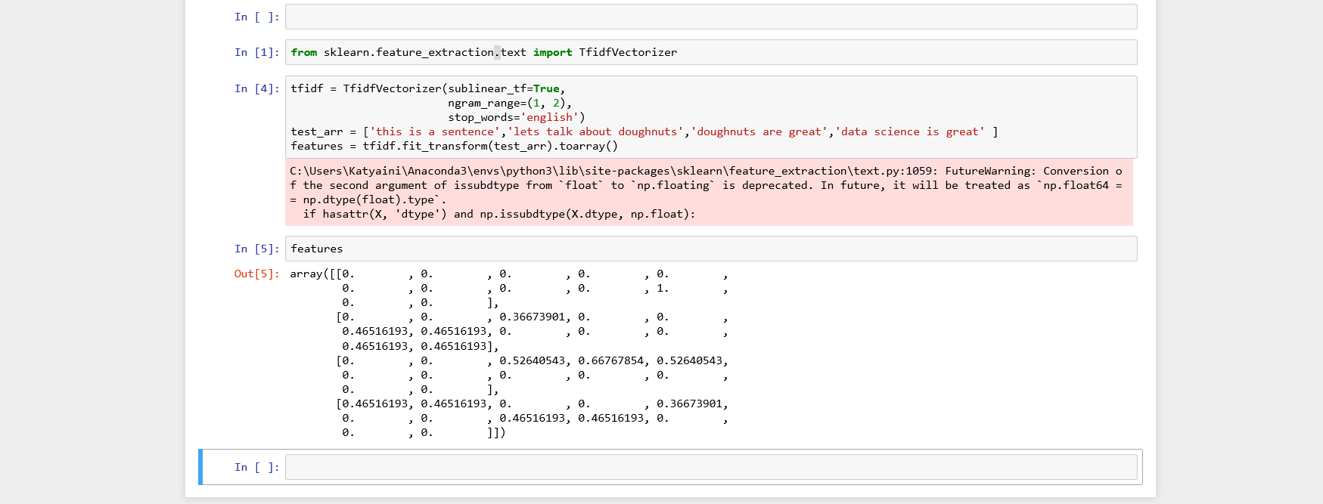
Tf-idf demo

Slide 8
Optimization and Interpretation
Do we really need all variables/features we have? Or why might it be useful to drop certain features?
Curse of dimensionality — Overfitting
Non informative features - Poor-quality input will produce Poor-Quality output.
large number of features make a model bulky, time-taking, and harder to implement in production.

Slide 9
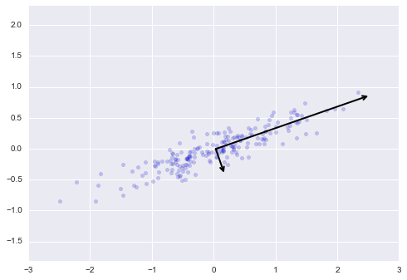
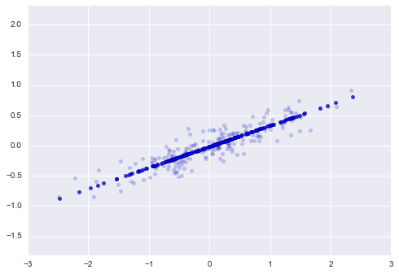
PCA: Drop dependent/insignificant variables

Slide 10
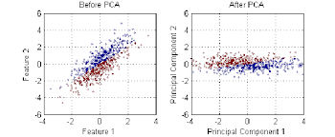
Why can we do this?
Notice how X and Y are linearly dependent- basically means knowing X you can predict y. No extra information is being provided by Y, so we can just combine info into 1 feature.

Slide 11
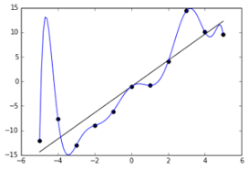
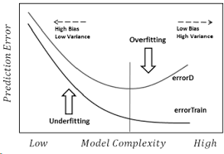
Overfitting
If we have more columns in the data than the number of rows, we will be able to fit our training data perfectly, but that won’t generalize to the new samples. And thus we learn absolutely nothing.
In this case your model will have low training error but high testing error

Slide 12

Solution : Regularization
Can you not only minimize the cost function but also restrict the parameters not to become too large?
Where λ is a constant to control the value of regularization term and n is the number of the features.
The regularization term penalizes large parameters. Obviously, minimizing the cost function consists of reducing both terms in the right: the MSE term and the regularization term. So each time some parameter is updated to become significantly large, it will increase the value of the cost function by the regularization term, and as a result, it will be penalized and updated to a small value.

Slide 13


L1(Lasso Regression) and L2(Ridge Regression)
Ridge Regression
“squared magnitude” of coefficient as penalty term
Lasso Regression
“absolute value of magnitude” of coefficient as penalty term

